Slide 1
Creating 3D Shapes
By Mrs. Doll’s
Kindergarten Class

Slide 2
We started with learning the difference between 2D and 3D shapes
2D shapes have two ways to measure them
Length and height
We learned the names of the shapes and had fun finding those shapes in our environment

Slide 7
We learned that 3D shapes have 3 ways to measure them
Length, height, and width
We learned the names for the shapes
We compared 2D and 3D shapes, and discovered that every 3D shape has a 2D shape on it

Slide 8
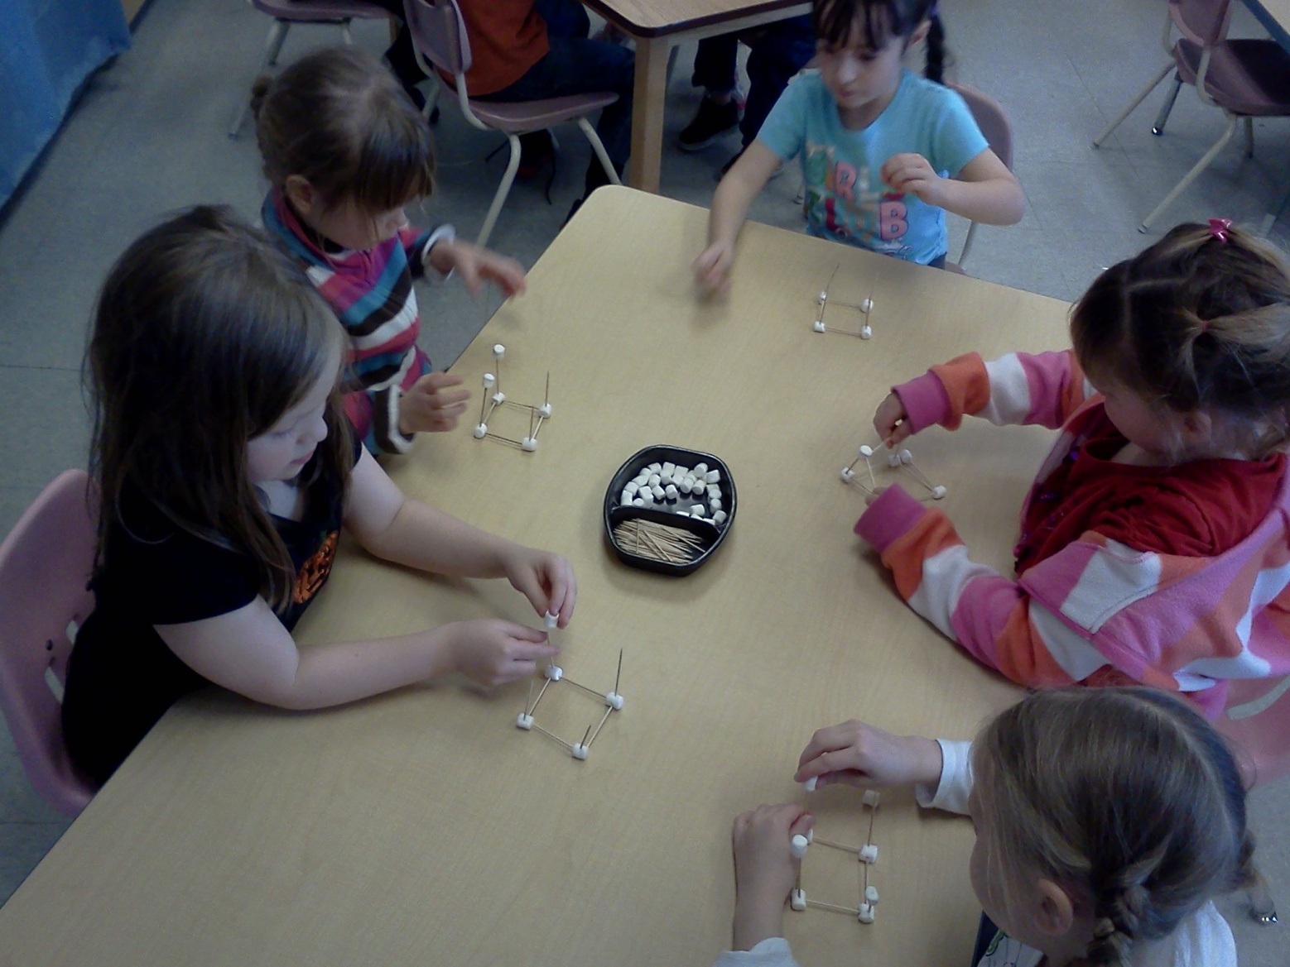
We experimenting with building 3D structures
We used marshmallows and toothpicks first

Slide 10
We discovered marshmallows don’t work very well for holding the toothpicks in place….
So we tried straws and clay…we had lots of fun forming our shapes

Slide 13
We learned we needed to start with a base to build our 3D structures just like the foundation of a house

Slide 14
Our finished products on display

